Slide 1

56
Pranit Patil
77
Vivek Pundkar
Types of
52
Amitesh Patil
Multi-Processing
54
Kshitij Patil

Slide 2






Index
Asymmetric Multiprocessing
Introduction
Conclusion
Symmetric Multiprocessing
Clustered Multiprocessing

Slide 3



Introduction
A multiprocessor system is defined as "a system with more than one processor", and, more precisely, "a number of central processing units linked together to enable parallel processing to take place".
Increased reliability
Increased throughout
The economy of Scale
Process a large volume of data

Slide 4


Classification
Multiprocessor system can be classified by the way their memory is organized.
1
Tightly Coupled Multiprocessor System
2
Loosely Coupled Multiprocessor System

Slide 5

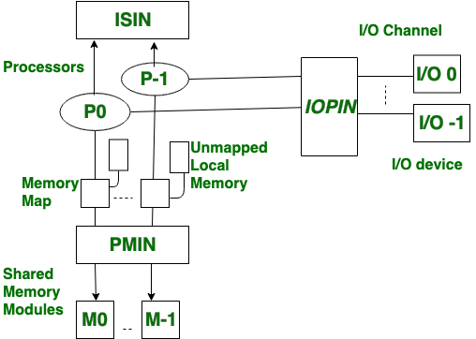
Tightly Coupled Multiprocessor System
It is a type of multiprocessing system in which, There is shared memory.
This system consist of processors, memory module and input-output channels.
These units are connected through PMIN(Processor Memory Interconnection Network), IOPIN(Input output processor Interconnection Network), ISIN (Interrupt Signal Interconnection Network).
It provides high speed.
It has memory conflicts.
It has a high data rate.
Compartmentalization
Routing

Slide 6
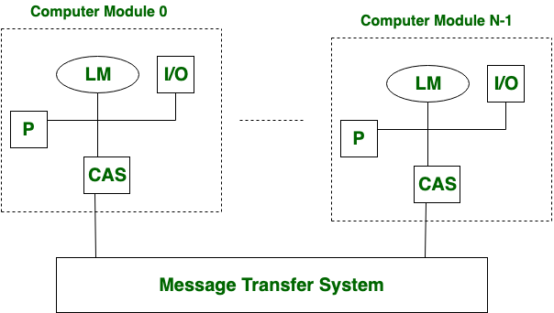
Loosely Coupled Multiprocessor System
It is a type of multiprocessing system in which, There is distributed memory.
In this system each processor has set of input-output devices and a large local memory and input–output interfaces are together called as computer module.
Processes which executes on different Computer Module communicate by exchanging message through MTS.
There are no memory conflicts in general.
It has a high data rate.
More flexible.
Compartmentalization
Routing

Slide 7
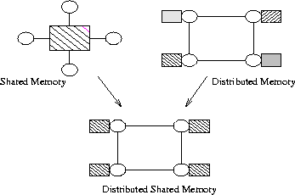
Parallel Processor Architecture
MIMD
Shared memory multiprocessor
Symmetric multiprocessing
Master/Slave
Distributed memory
(self-contained computer)
Clusters

Slide 8

What is Symmetric multiprocessing?
SMP refers to the computer architecture where multiple identical processors are interconnected to a single shared main memory, with full accessibility to all the I/O devices.
All the processors have common shared(common) memory and same data path or I/O bus.
All CPU has equal rights as there is no masters-slave architecture.

Slide 9
Symmetric multiprocessing architecture
MAIN MEMORY
System Bus
BUS ARBITER
CACHE
CACHE
CACHE
I/O
....
PROCESSOR 1
PROCESSOR 2
PROCESSOR
N

Slide 10


Characteristics of SMP
Identical
All the processors are treated equally , so they all are identical.
Communication
Shared memory is the mode of communication among processors.
Complexity
Are complex in design, as all units share same memory and data bus.

Slide 11


Pros and cons of SMP
CPU
CPU
Throughput
Reliability
CPU
CPU
Cost
Complex design
Since all the processors are treated equally by OS, so designing and management of such OS become difficult.

Slide 12


What is Asymmetric multiprocessing
An asymmetric multiprocessing (AMP or ASMP) system is a multiprocessor computer system where not all of the multiple interconnected CPU’s are treated equally.
The processors in asymmetric multiprocessing may have a master slave relationship
Not self scheduling and independent
Asymmetric multiprocessing provides an execution environment that's similar to conventional uniprocessor systems.

Slide 13
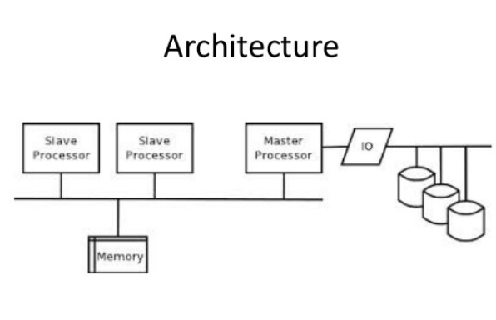
Architecture
And only the master processor runs the task of the Operating System
The master processor control and assign the tasks to the other Slave processors as per the Admin needs.
This type of processing is on the advantage when the user needs to assign specific tasks to the CPU based on the Priority.

Slide 14






Types of AMP’s
Homogenous AMP
Each CPU runs the same type and version of the OS
Applications running on one CPU can communicate transparently with applications and system services on other CPUs.
Heterogenous AMP
Each CPU runs either a different OS or a different version of the same OS
You must either implement a proprietary communications scheme or choose two OSs that share a common infrastructure (likely IP based) for inter-processor communications.

Slide 15

Asymmetric Multiprocessing
Symmetric Multiprocessing
In asymmetric multiprocessing, the processors are not treated equally. | In symmetric multiprocessing, all the processors are treated equally.
Tasks of the operating system are done by master processor. | Tasks of the operating system are done individual processor
No Communication between Processors as they are controlled by the master processor. | All processors communicate with another processor by a shared memory.
In asymmetric multiprocessing, process are master-slave. | In symmetric multiprocessing, the process is taken from the ready queue.
Asymmetric multiprocessing systems are easier to design If a processor fails in symmetric multiprocessing, its tasks are divided among the other processors and efficiency of system reduces. | Symmetric multiprocessing systems are complex to design Here, if a master processor fails than a slave processor is designated as master and if a slave processor fails, its tasks are divided among the other slaves.

Slide 16


Need of clustered multi-programming
Issues with SMP
Complex inter process communication
Performance expensive tasks such as context-switching
Issues with ASMP
Software are written according to no. of cores and CPUs.
Very complex software and costly to developer.
No load-balancer.
Issues with ASMP
Diminishing performance increase with increase in no. of cores and CPU

Slide 17



Solution
Amdahl’s Law:
The overall performance improvement gained by optimizing a single part of a system is limited by the fraction of time that the improved part is actually used.
Increase parallelization by increasing efficiency

Slide 18

What does CMP offer?
1
load balancing and high availability provided by SMP
2
limited context-switching and special purpose processor utilization of ASMP
Elimination of shared-memory model and reducing the inter-process communications
3

Slide 19



Prerequisite
TMM: Traffic Management Microkernel
A single-threaded, non-context-switching process optimized specifically for processing Application Delivery Network traffic.
TMM is designed to easily facilitate ASMP principles to incorporate performance improvements from special-purpose processors.
TMOS: Traffic Management operating system
Not an operating system
Includes a collection of operating systems and firmware, all of which run on BIG-IP hardware appliances
purpose-built software platform on which F5 products run, is extremely efficient when run on a single core.
BIG-IP system:
The BIG-IP platform is a smart evolution of Application Delivery Controller (ADC) technology.

Slide 20

Use Cases Of TMOS
To use SMP to distribute TMOS process across multiple processors—with shared memory, network card, and special purpose processors.
1
To run multiple instances of the TMM on different processors—still with the requisite shared memory, network card, and special-purpose processors.
2
Instead, CMP enables load balancing of multiple processing cores, each with its own dedicated memory, network interface, and special-purpose processors
3

Slide 21


How almost double performance is achieved?
Acts as a hardware-based load balancer
Distributes traffic flows between the independent TMM instances.
HSB: High Speed Bridge
Enables TMM instances to share information. This provides the unsurpassed throughput and interconnectivity of each processor’s dedicated network interfaces.

Slide 22
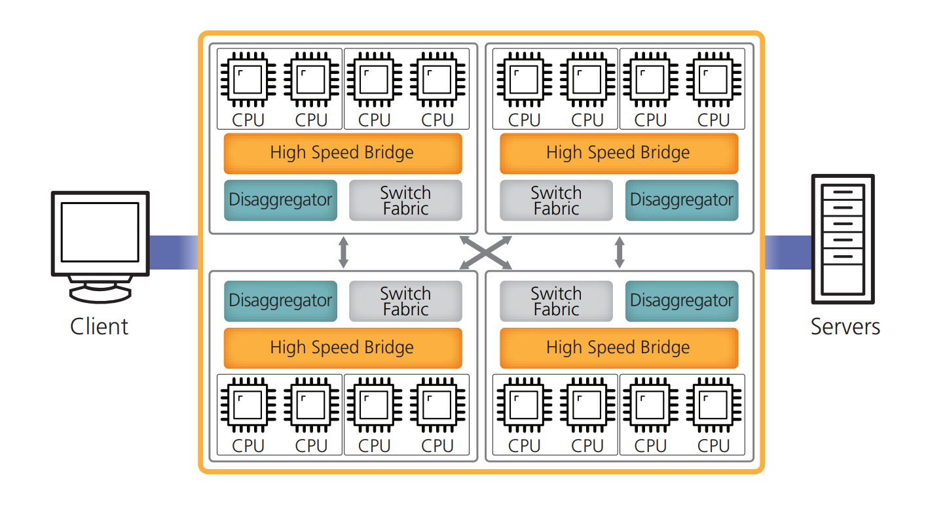

Slide 23


